Slide 1

6th Grade Accelerated Math Unit 7, Lesson 8 Finding the Area of Composite Figures Volume 1, pg. 338

Slide 2


Benchmark
MA.7.GR.1.2
Solve mathematical or real–world problems involving the areas of polygons or composite figures by decomposing them into triangles or quadrilaterals.
volume 1, pg. 338

Slide 3
Integrated Mathematical Thinking and Reasoning Standards
MA.K12.MTR.1.1 Actively participate in effortful learning both individually and collectively.
MA.K12.MTR.2.1 Demonstrate understanding by representing problems in multiple ways.
MA.K12.MTR.4.1 Engage in discussions that reflect on the mathematical thinking of self and others.
MA.K12.MTR.5.1 Use patterns and structure to help understand and connect mathematical concepts.
volume 1, pg. 338

Slide 4

Learning Target
I can decompose composite figures into triangles and quadrilaterals to find the area.
volume 1, pg. 338

Slide 5

Warm-Up
volume 1, pg. 338

Slide 6

7.8.1 Warm-Up: Math Fail
The advertisement below is for the sale of colored strands for braids to raise money for a Stop Drug Abuse campaign.
Explain what the math fail
is in the advertisement.
volume 1, pg. 338

Slide 7

Guided Instruction
volume 1, pg. 339

Slide 8

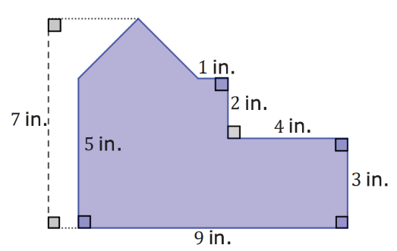
7.8.2 Guided Instruction: Finding the Area of Polygons
A floorplan is shown. All segment lengths are in inches (in.).
With your partner, decompose the floorplan into triangles and quadrilaterals.
Find the area of the floorplan. Show your work.
volume 1, pg. 339

Slide 9
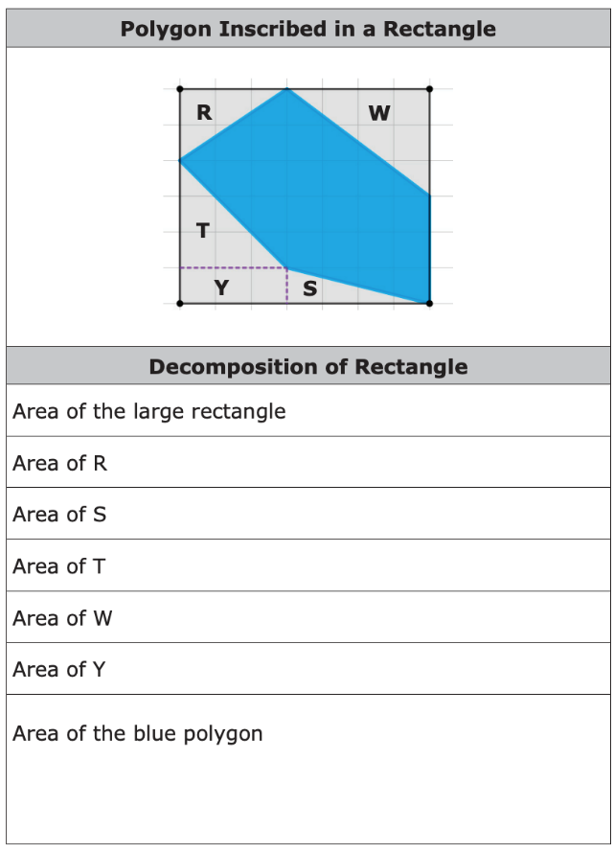
3. A polygon inscribed inside a rectangle is shown on the grid. Each grid line is 1 unit.
a. Complete the table.
volume 1, pg. 339

Slide 10
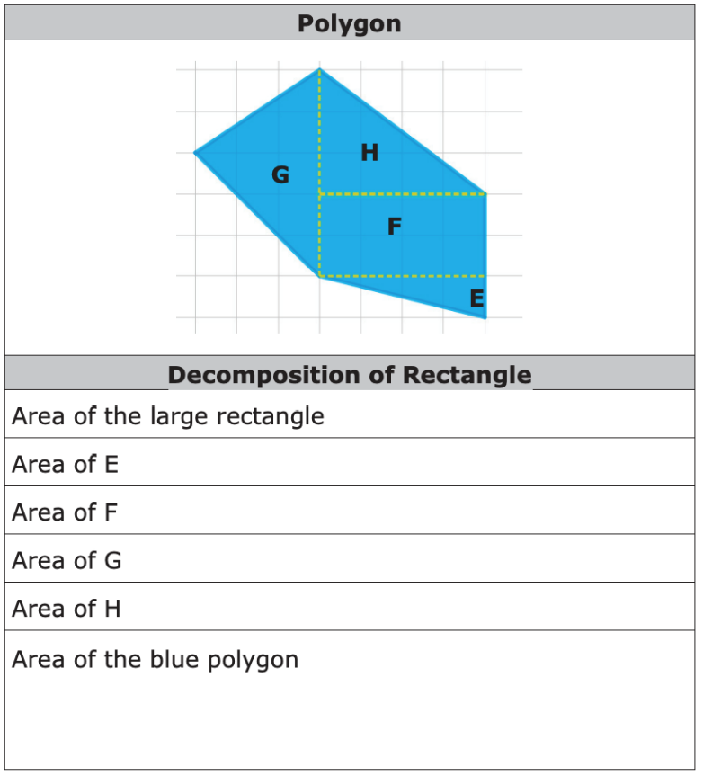
b. The same polygon is shown on the grid. Each grid line is 1 unit.
volume 1, pg. 340

Slide 11
c. Discuss with your partner the different possible methods of finding the area of the blue polygon. List one strength of each method.
volume 1, pg. 340

Slide 12

Collaboration
volume 1, pg. 340

Slide 13

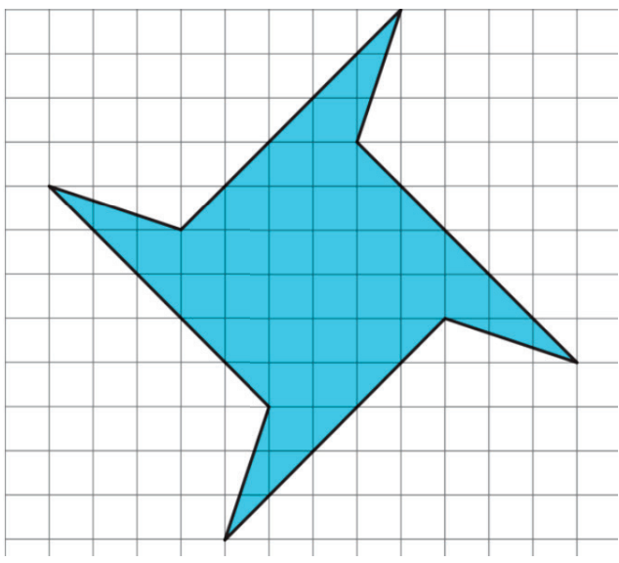
7.8.3 Collaboration: Area of a Polygon
1. A polygon is shown on grid paper. Each grid line is 1 unit.
Decompose the polygon into triangles and quadrilaterals.
Share your decomposition with your partner. List at least one similarity and one difference.
volume 1, pg. 340

Slide 14
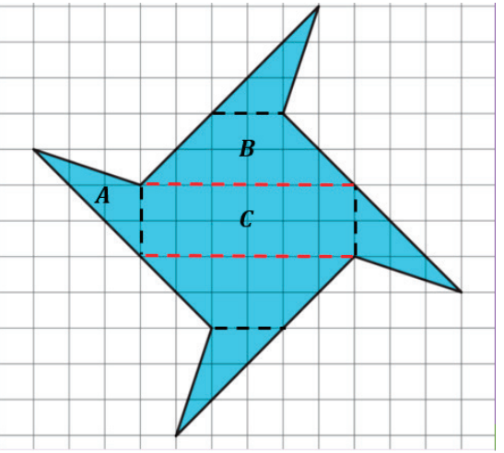
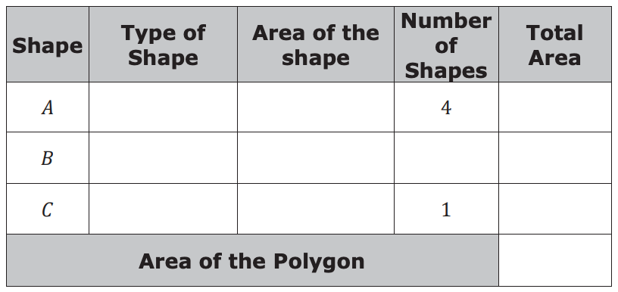
2. Taahira decomposed the polygon into 7 pieces using 3 different shapes, as shown. Each grid line is 1 unit.
Work with your partner to find the area of each shape and the total area of the polygon.
volume 1, pg. 341

Slide 15

Guided Practice
volume 1, pg. 341

Slide 16

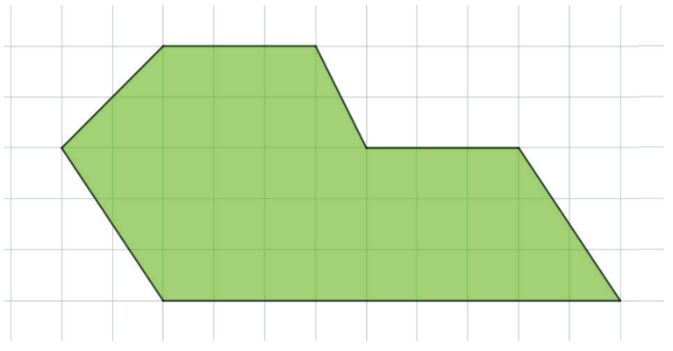
7.8.4 Guided Practice: Decomposing Composite Figures to Find Area
A polygon is shown on a grid. Each grid line is 1 unit.
Find the area of the polygon.
volume 1, pg. 341

Slide 17
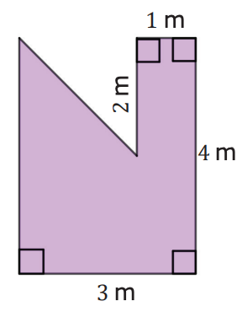
2. A polygon is shown with the given measurements in meters (m).
What is the area of the composite figure?
volume 1, pg. 342

Slide 18

Your Turn
volume 1, pg. 342

Slide 19
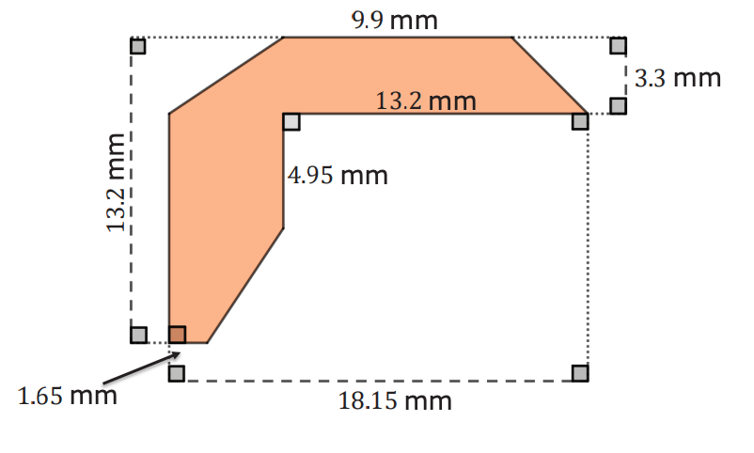
7.8.5 Your Turn!
1. Find the area of the polygon. Lengths are shown in millimeters (mm).
volume 1, pg. 342

Slide 20

Wrap-Up
volume 1, pg. 343

Slide 21
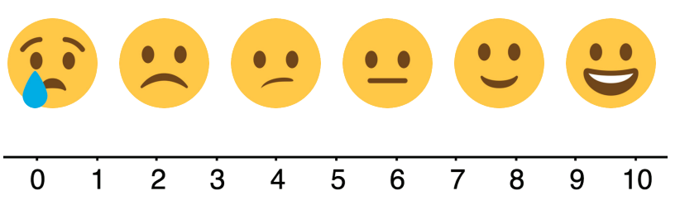
7.8.6 Wrap-Up: Reflection
Place an X on the number in the emoji scale that indicates your understanding in relation to today’s learning target.
I can decompose composite figures into triangles and quadrilaterals to find the area.
2. Provide evidence to explain your self-assessment.
volume 1, pg. 343

